Slide 1
Nevada Maternal Mortality Review Committee review of Nevada Revised statutes and AB 119 of the 81st Legislative Session
Tami Conn
Health Program Specialist II
Nevada Division of Public and Behavioral Health, Maternal, Child, and Adolescent Health Section

Slide 2
Define maternal mortality
Maternal Mortality Review Committee (MMRC) Overview
Nevada Revised Statues(NRS) MMRC Regulations and AB 119 of the 81st Legislative Session
Reporting timeline
Data overview
2020 MMRC report recommendations
AIM and MMRC
Summary of Advisory Committee of the Office of Minority Health and Equity MMRC responsibilities

Slide 3
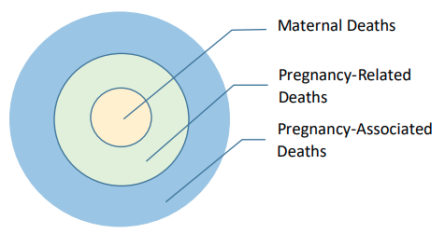
Maternal Mortality
Notes:
Pregnancy-Associated Death is the death of a woman while pregnant or within one year of the termination of pregnancy, regardless of the cause. Pregnancy-associated death ratio is the number of pregnancy-associated deaths per 100,000 live births.
Pregnancy-Related Death is the death of a woman during pregnancy or within one year of the end of pregnancy, from a pregnancy complication, a chain of events initiated by pregnancy, or the aggravation of an unrelated condition by the physiologic effects of pregnancy. Pregnancy-related death ratio is the number of pregnancy-related deaths per 100,000 live births.
Maternal Death is the death of a woman while pregnant or within 42 days of the termination of pregnancy, regardless of the duration and site of pregnancy, from any cause related to or aggravated by the pregnancy or its management, but not from accidental or incidental causes.

Slide 4
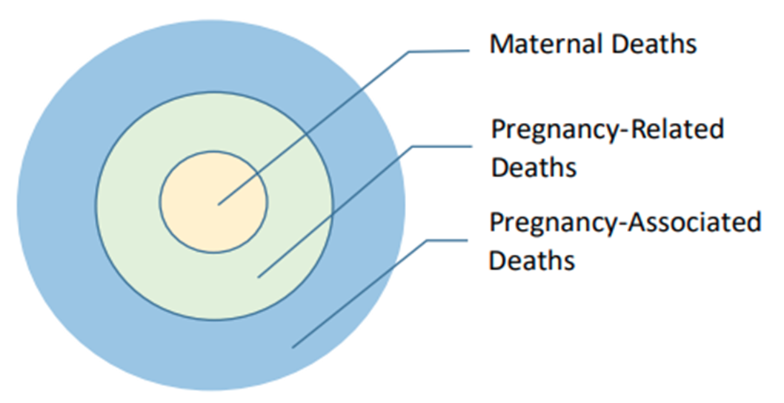
Definitions
Pregnancy-Associated Death
Pregnancy-Related Death
Maternal Death
Death of a woman while pregnant or within one year of the termination of pregnancy, regardless of the cause.
Death of a woman during pregnancy or within one year of the end of pregnancy, from a pregnancy complication, a chain of events initiated by pregnancy, or the aggravation of an unrelated condition by the physiologic effects of pregnancy.
Death of a woman while pregnant or within 42 days of the termination of pregnancy, regardless of the duration and site of pregnancy, from any cause related to or aggravated by the pregnancy or its management, but not from accidental or incidental causes.

Slide 5
Maternal Mortality Review Committees (MMRCs)
Maternal Mortality Review Committees (MMRCs) are multidisciplinary committees in states and cities that perform comprehensive reviews of death among women within a year of the end of a pregnancy.
Centers for Disease Control and Prevention (CDC ) works with MMRCs to improve review process that inform recommendations for preventing future deaths.
Maternal Mortality Review Information Application (MMRIA) is a data system designed to facilitate MMRC functions through collecting data, documenting committee deliberations and standardizing indicators.

Slide 6
NRS 442.751 – 442.774
NRS 442.757 “Maternal mortality” defined. [Effective January 1, 2020.] “Maternal mortality” means the death of a woman during pregnancy, childbirth or the 365 days immediately following the end of a pregnancy.
https://www.leg.state.nv.us/nrs/nrs-442.html

Slide 7
NRS 442.764 - Committee Make up
2. The Director shall appoint to the Committee not less than 6 members and not more than 12 members who:
(a) Are providers of health care, representatives of nonprofit organizations whose work is related to health care or women’s issues, representatives of agencies involved in vital statistics, law enforcement and public health and other persons interested in maternal health and welfare; and
(b) Represent the racial, ethnic, linguistic and geographic diversity of this State.

Slide 8
NRS 442.767 Duties (AB119 changes in blue)
(a) Identify and review each incident of maternal mortality in this State, regardless of the cause of death. Such a review must include, without limitation and to the extent that such records exist, a review of relevant medical records, birth and death certificates, records of an autopsy, records created by a medical facility or provider of emergency medical services, records of a social services agency, mental health records and records of a law enforcement agency described in NRS 442.774.
(b) Use the Maternal Mortality Review Information Application developed by the Centers for Disease Control and Prevention of the United States Department of Health and Human Services or, if that
application ceases to exist, a similar application designated by the Director, to conduct reviews pursuant to paragraph (a).
(c) Within the limits of available resources [, review] :
  (1) Review incidents and trends in severe maternal morbidity in this State.
  (2) Identify and review disparities in the incidence of maternal mortality in this State by analyzing:
    (I) The race, ethnicity and age of mothers who experience maternal mortality;
    (II) The geographic region of the residence of mothers who experience maternal mortality; and
    (III) Any other variables identified by the Committee.
(d) Based on the reviews conducted pursuant to paragraphs (a) and (c), develop recommendations to prevent maternal mortality and severe maternal morbidity and disseminate findings and recommendations to providers of health care, medical facilities, other interested persons and entities and the public.

Slide 9
NRS 442.767 Duties. - Reporting
(f) On or before December 31 of each even-numbered year and in collaboration with the Advisory Committee of the Office of Minority Health and Equity of the Department and the Chief Medical Officer, develop and submit to the Director of the Legislative Counsel Bureau for transmittal to the next regular session of the Legislature a report that includes, without limitation:

Slide 10
MMRC and NOMHE timeline for report
Bi-annual in even numbered years, a report is due December 31
Must contain
  (1) A description of the incidents of maternal mortality and severe maternal morbidity reviewed pursuant to paragraph (a) and subparagraph (1) of paragraph (c), respectively, during the immediately preceding 24 months, provided in a manner that does not allow for the identification of any person;
  (2) A summary of the disparities identified and reviewed pursuant to subparagraph (2) of paragraph (c);
  (3) Plans for corrective action to reduce maternal mortality and severe maternal morbidity in this State; and
  (4) Recommendations for any legislation or other changes to policy to reduce maternal mortality and severe maternal morbidity or otherwise improve the delivery of health care in this State.
Report will be written in late October and early November
  Will need to have last minute additions based on November and December death
NOMHE advisory board will review report and make recommendations at November meeting

Slide 11
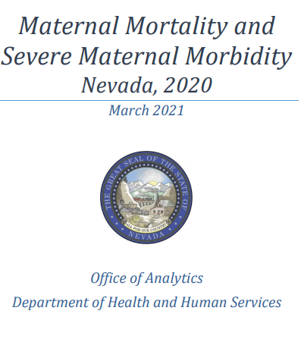
Maternal Mortality and Severe Maternal Morbidity
https://dhhs.nv.gov/uploadedFiles/dhhsnvgov/content/Programs/Office_of_Analytics/Maternal%20Mortality%20and%20Severe%20Maternal%20Morbidity%20Report%202020.pdf
Notes:
Report can be found online

Slide 12
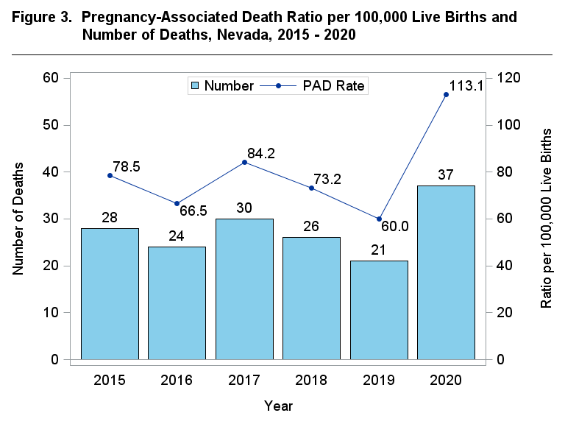
Maternal Mortality: Pregnancy-Associated Deaths (PAD)
PAD Ratio per 100,000 Live Births and Number of Deaths, Nevada, 2015-2020
Data Source: Office of Analytics Report: Maternal Mortality and Severe Maternal Morbidity Nevada, 2020
Notes:
Pregnancy-Associated Death is the death of a woman while pregnant or within one year of the termination of pregnancy, regardless of the cause. Pregnancy-associated death ratio is the number of pregnancy-associated deaths per 100,000 live births.
No consistent increasing or decreasing trend in ratio, large spike in 2020 possibly due to COVID
Next slides focus on 2020 breakdowns
In 2020, the most common single cause of death was nontransport accidents, accounting for 24.3% of all pregnancy‐associated deaths. The second most common death cause was both pregnancy, childbirth and the puerperium, and transport accidents, each accounting for 10.8% of all deaths. All nontransport accidents deaths were due to unintentional drug overdose

Slide 13
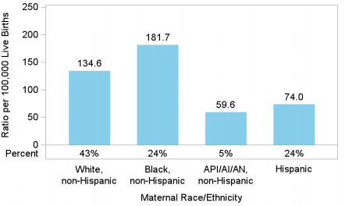
Maternal Mortality: PAD
PAD Ratio and Percent by Race/Ethnicity, Nevada, 2020
Data Source: Office of Analytics Report: Maternal Mortality and Severe Maternal Morbidity Nevada, 2020
Notes:
Black, non‐Hispanic women had the highest pregnancy‐associated death ratio at 181.7 per 100,000 live births and 24% of the pregnancy‐associated deaths. Asian/Pacific Islander/American Indian/American Native (API/AI/AN), non‐Hispanic women had lowest death ratio at 59.6 per 100,000 live births, accounting for 5% of all deaths.

Slide 14
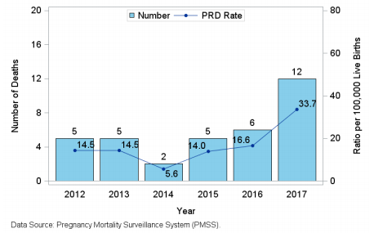
Maternal Mortality: Pregnancy-Related Deaths (PRD)
PRD Ratio per 100,000 Live Births and Number of Deaths, Nevada, 2012-2017
Notes:
During 2016 and 2017, the most common death causes of pregnancy‐related deaths were hemorrhage, thrombotic embolism, and hypertensive disorders of pregnancy, each accounting for 16.7% of all pregnancy‐related deaths.
Pregnancy-Related Death is the death of a woman during pregnancy or within one year of the end of pregnancy, from a pregnancy complication, a chain of events initiated by pregnancy, or the aggravation of an unrelated condition by the physiologic effects of pregnancy. Pregnancy-related death ratio is the number of pregnancy-related deaths per 100,000 live births.
There were 35 pregnancy‐related deaths for Nevada residents from 2012 to 2017, according to data from PMSS. There was no consistent increasing or decreasing trend in the pregnancy‐related death ratio, with the highest ratio in 2017, at 33.7 per 100,000 live births. There were 18 pregnancy‐related deaths, with a ratio of 25.1 per 100,000 live births from 2016 to 2017

Slide 15
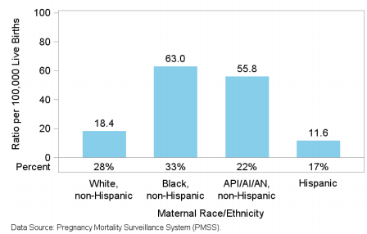
Maternal Mortality: PRD
PRD Ratio and Percent by Race/Ethnicity Nevada, 2016-2017
Notes:
Black, non‐Hispanic women had highest pregnancy‐related death ratio at 63.0 per 100, 000 live births and 33% of the pregnancy‐related deaths occurred among Black, non‐Hispanic women. Hispanic women had lowest death ratio at 11.6 per 100,000 live births, accounting for 17% of all deaths.

Slide 16
2020 report recommendations
The MMRC Committee reviewed five maternal mortality cases in 2020
The need to provide adequate drug treatment options to pregnant women.
  The Committee recommends educating providers on Nevada's substance use disorder treatment options which already exist for pregnant women and removing barriers to care.
The need for identification of substance use in pregnancy and the identified need as a society to address the social determinants of health.
  At the provider level, the utility of recommending the use of a suicide screen in addition to the antepartum and postpartum depression screen was discussed.

Slide 17
2020 report recommendations (cont.)
A recommendation for outreach promoting the importance of prenatal care and preventing delays in prenatal care was identified.
The Committee identified two recommendations to improve the function of the committee.
  The statutory language is a barrier to accessing Nevada Central Cancer Registry data. The Committee recommends considering legislative action to remove the barrier to receive these records for case abstraction.
  The Committee identified the lack of family interviews and data regarding the social determinants of health as a barrier to making recommendations from the cases. The Committee recommends considering securing dedicated funding to ensure full data collection.

Slide 18
Resources
Maternal, Child and Adolescent Health Section (MCAH) Data and Publications
Title V Data Dashboard
MMRC 2020 Annual Report
CDC MMRC Site
AIM National Site
NRS 442 – Maternal and Child Health

Slide 19
The Alliance for Innovation on Maternal Health (AIM) and the MMRC
AIM is a national data-driven maternal safety and quality improvement (QI) initiative.
Nevada became an AIM state in 2020 with its first patient safety bundle on Severe Hypertension launching in Fall of 2021.
AIM has a clinical hospital focus
AIM and the MMRC work towards similar goals, the reduction of SMM but are two separate programs.
  Both programs are managed by the same support staff

Slide 20
Tami Conn
State Systems Development Initiative Manager
tconn@health.nv.gov
Vickie Ives, MA
MCAH Section Manager
vives@health.nv.gov

Slide 21
Summary of Advisory Committee of the Office of Minority Health and Equity MMRC responsibilities per AB 119 of the 81st Legislative Session
Review MMRC report in November and provide feedback and recommendations on the following topics:
  Maternal Mortality (MMRC draft report and Office of Analytics data report)
  Severe Maternal Morbidity (Office of Analytics data report)
  Summary of disparities in SMM and MM
  Plans for corrective action to reduce SMM and MM
  Recommendations for any legislation or other changes to policy to reduce SMM and MM or otherwise improve the delivery of healthcare in Nevada
**The Advisory Committee of the Office of Minority Health and Equity may not access any information deemed as confidential pursuant to NRS 442.774 while collaborating with the Committee in the development of the report

