Slide 1


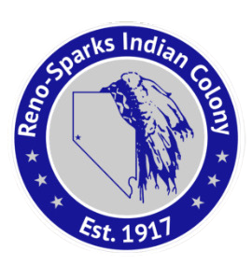
Celebrating Advancements in Tribal Health Care with Senate Bill 312 and Senate Bill 97
Angie Wilson, Reno Sparks Tribal Health Center Director

Slide 2
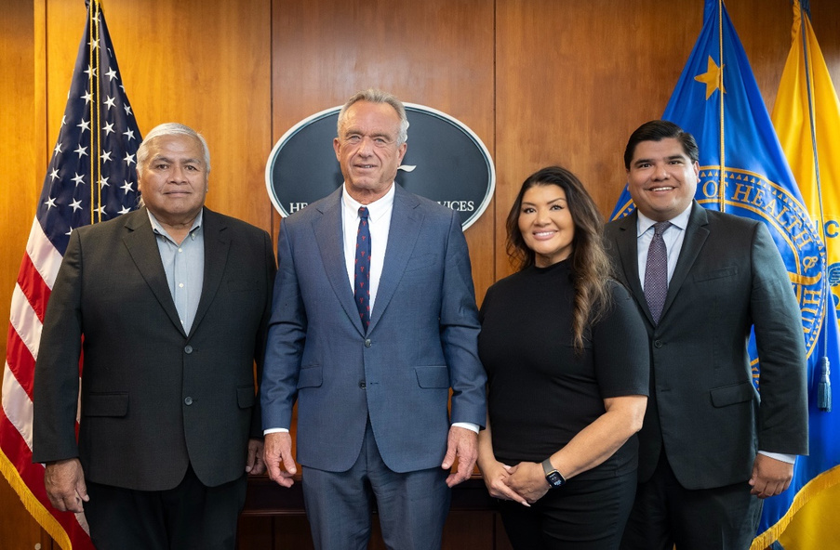

RSIC Chairman Daryl D. Gardipe, U.S. Department of Health and Human Services Secretary Robert F. Kennedy, Jr., Angie Wilson, RSIC Tribal Health Director and Mark Cruz, HHS Secretary’s Senior Advisor
“Indian Country is not just a concern of mine—it is a top priority. We cannot Make America Healthy Again without making Native health a central focus…” - U.S. Department of Health and Human Services Secretary Robert F. Kennedy, Jr.
TRIBAL
ADVOCACY
The United States has a unique historical, legal, and political relationship with Tribal Nations, established through and confirmed by the Constitution, federal laws, supreme court case law, and presidential orders. Born out of this relationship is the federal government’s trust responsibility to protect the interests of Tribes, including the provision of quality healthcare to American Indians and Alaska Natives.
This commitment underscores the necessity for ongoing tribal advocacy, as it ensures that these healthcare promises are upheld and adapted to meet the evolving needs of Native communities. Tribal advocacy is crucial in voicing concerns, pushing for policy changes, and securing resources, thereby playing a pivotal role in maintaining and improving healthcare outcomes for American Indians.

Slide 3
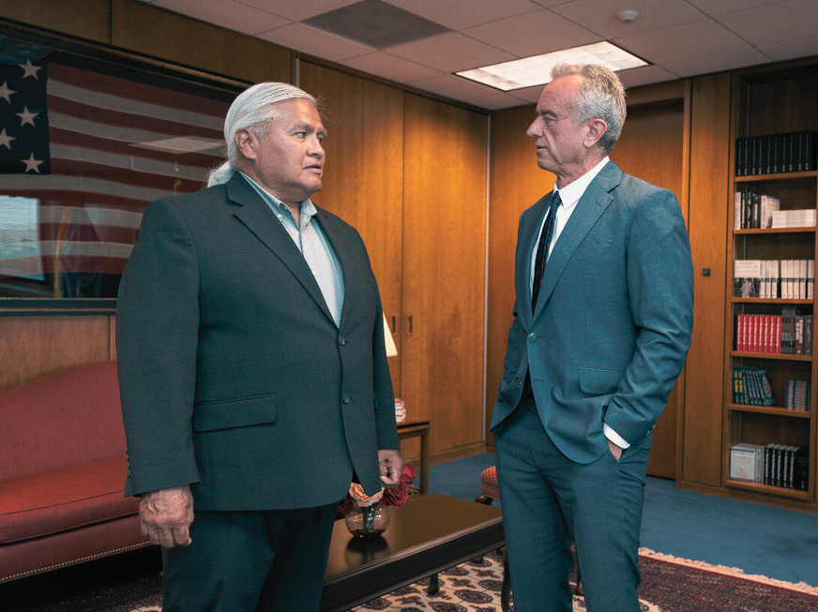
FROM ADVOCACY TO ACTION
The One Big Beautiful Bill includes important exemptions for American Indians, acknowledging the distinct needs and sovereignty of tribal communities. These exemptions aim to ensure that the unique cultural, economic, and social aspects of American Indian life are respected and preserved.
Despite these provisions, there remains a strong need for continued tribal advocacy to ensure that our voices are heard and our rights are upheld. Ongoing engagement and dialogue between tribes and policymakers are crucial to addressing emerging challenges and safeguarding the future of American Indian communities.

Slide 4
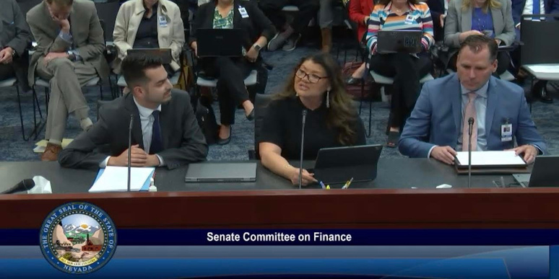
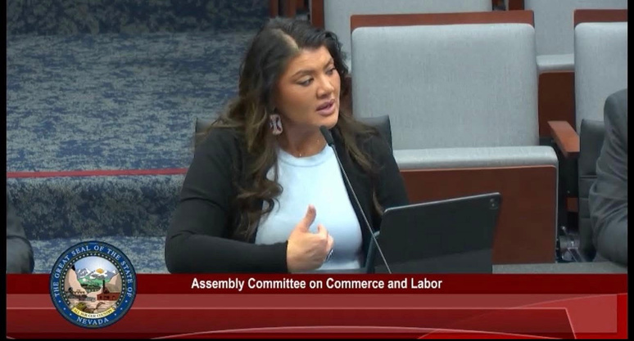
DRAFTING OF SENATE BILL 312
During the 83rd Nevada State Legislative Session, a significant collaboration took place between the Reno Sparks Indian Colony and the Senate Committee on Health and Human Services. Together, they worked on the development of Senate Bill 312, which led to the establishment of the Tribal Health Authority Council. This collaborative effort aimed to address healthcare disparities faced by Nevada's tribal communities.
In the drafting of Senate Bill 312, the Tribal Health Authority Council aimed to focus on expanding healthcare programs, services, staffing, and infrastructure for tribal clinics. This initiative was a goal for a lasting impact, leading to better healthcare outcomes for Nevada's tribal communities for generations to come. The collaboration between the legislative committees and tribal authorities underscores a commitment to improving health equity and access for all.

Slide 5
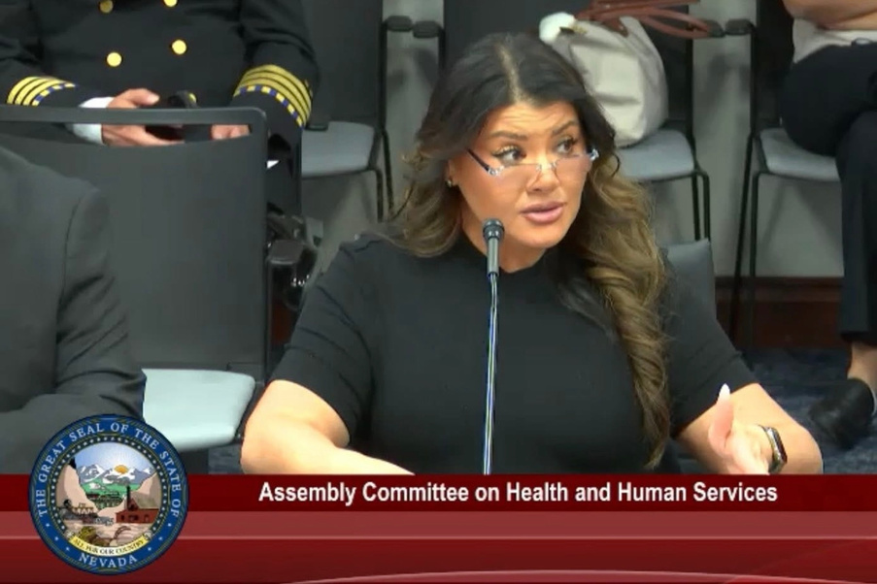

SENATE BILL 312
NEVADA TRIBAL HEALTH AUTHORITY COUNCIL
Senate Bill 312 was recently passed, leading to the establishment of the Nevada Tribal Health Authority Council. This council aims to address and improve healthcare services for Native American communities within the state. It will work collaboratively to identify health needs, develop strategies, and implement programs tailored to enhance the well-being of our tribal communities. The council is expected to serve as a critical link between tribal entities and state health resources, ensuring culturally appropriate and effective healthcare delivery.
Senate Bill 312 specifically includes the following provisions:
Establishes the Nevada Tribal Health Authority Council
Comprised of Nevada Tribal Health Directors or designees
Establishes the account for Tribal Health in the State General Fund
Appropriates $224K to the Department of Native American Affairs for personnel and operating costs of the Council
Authorizes the Council to request up to two legislative measures each legislative session
Authorizes Indian Tribes to determine presumptive eligibility for Medicaid benefits

Slide 6
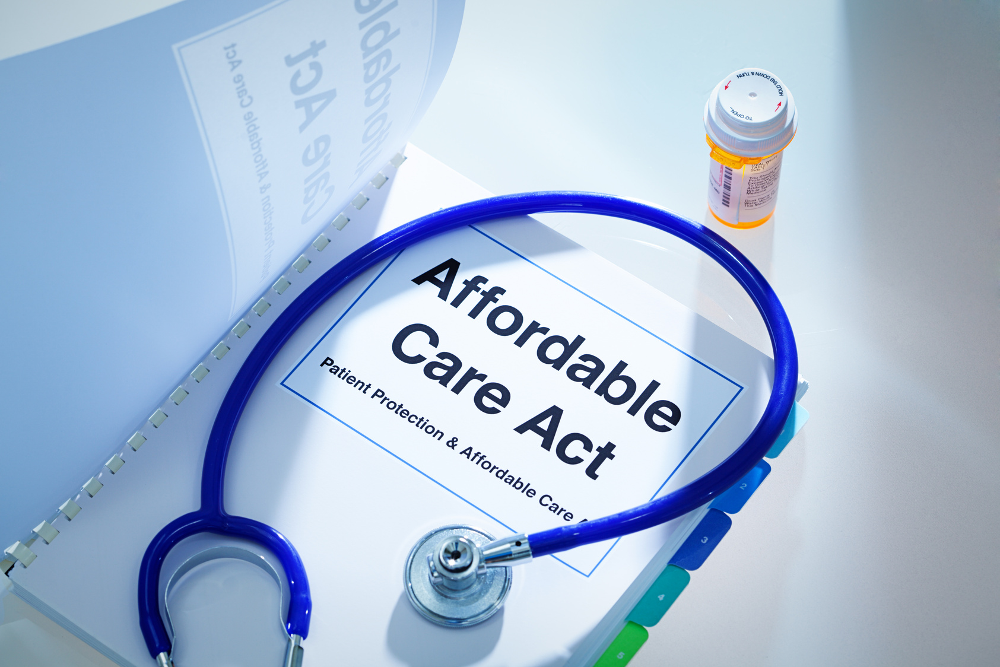
SENATE BILL 97
The Affordable Care Act (ACA) includes several provisions specifically designed to address the healthcare needs of American Indians and Alaska Natives (AI/AN). One significant aspect is the permanent reauthorization of the Indian Health Care Improvement Act, which strengthens the Indian Health Service (IHS) and expands its services. The ACA also offers AI/AN individuals greater flexibility in health insurance coverage, including exemptions from certain penalties for not having coverage, along with continuous open enrollment opportunities.
Additionally, the ACA provides funding to improve tribal healthcare facilities and workforce development, allowing for better access to quality care. It ensures that AI/AN individuals can access preventive services at no cost. These provisions aim to reduce health disparities and improve overall health outcomes for AI/AN communities by ensuring culturally appropriate and accessible healthcare services.
Furthermore, the ACA outlines specific mechanisms like tribal sponsorship and aggregate billing allowances. Tribal sponsorship allows tribes to pay premiums on behalf of AI/AN members, facilitating their enrollment in health plans. This ensures that individuals receive the necessary coverage without bearing the financial burden. Aggregate billing allows tribes to consolidate billing for members enrolled in qualified health plans, simplifying the administrative process and improving efficiency. These measures provide vital support and flexibility to tribal entities in managing healthcare coverage for their members.

Slide 7
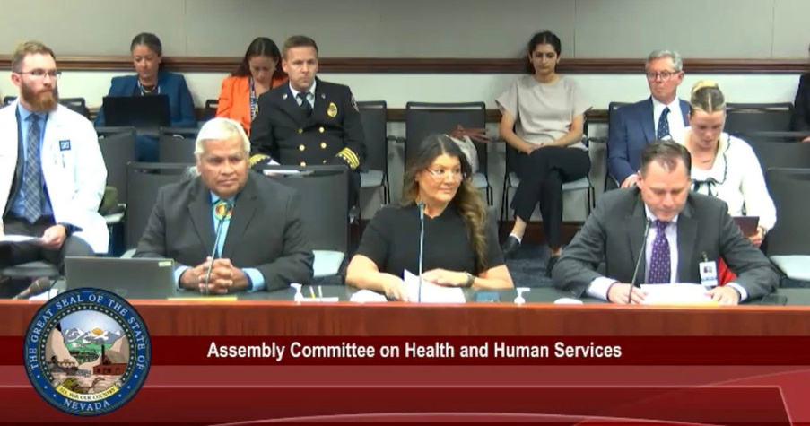
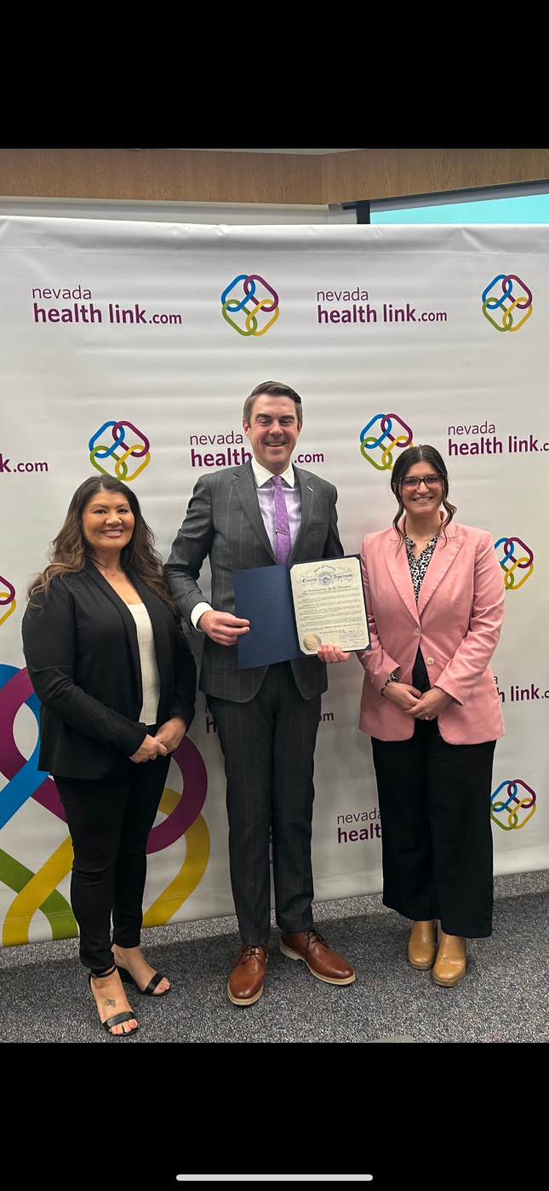
SENATE BILL 97
Nevada Senate Bill 97 (SB97) for the 2025 legislative session makes revisions to the Silver State Health Insurance Exchange. Specifically, it modifies the composition of the Board of Directors. The bill mandates that one of the Governor's appointees to the Board must be a member of a Nevada Indian tribe with expertise in tribal health care administration. This addition ensures better representation and expertise in tribal healthcare within the Exchange's governing body.

Slide 8
QUESTIONS OR COMMENTS

